Slide 1
Automating Your Qualtrics-to-LAVA Pipeline with R
Patrick Callahan
UCSF Memory and Aging Center
09/01/2020
Notes:
Welcome, and thank you all for joining!
Everyone is muted by default, but feel free to ask questions along the way in the chat—note the slide number in your question
I’ll answer these questions at the end of this short presentation on Automating your Qualtrics to Lava Pipeline with R
Today’s presentation is very much tailored to CRC job duties, particularly when it comes to transferring data from Qualtrics to LAVA.
The end-goal, of course, being that you can automate most of that process, and free up time to engage in other activities, while also creating a systematic way of transferring your team's data such that successors to your positions can maintain workflow continuity.
So in order to understand the process at hand, we’ll first need to discuss the Qualtrics API, or more generally, what an API is.
So with that, what is an API?

Slide 2
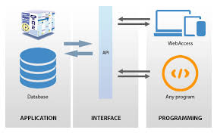
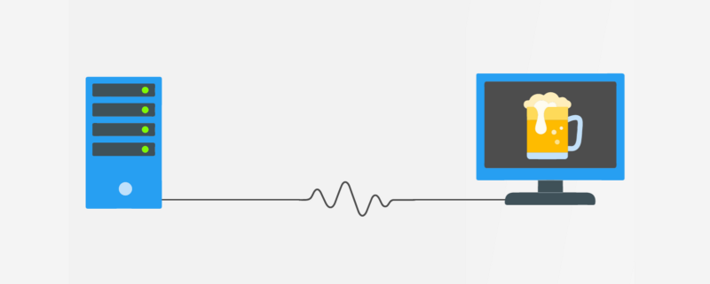
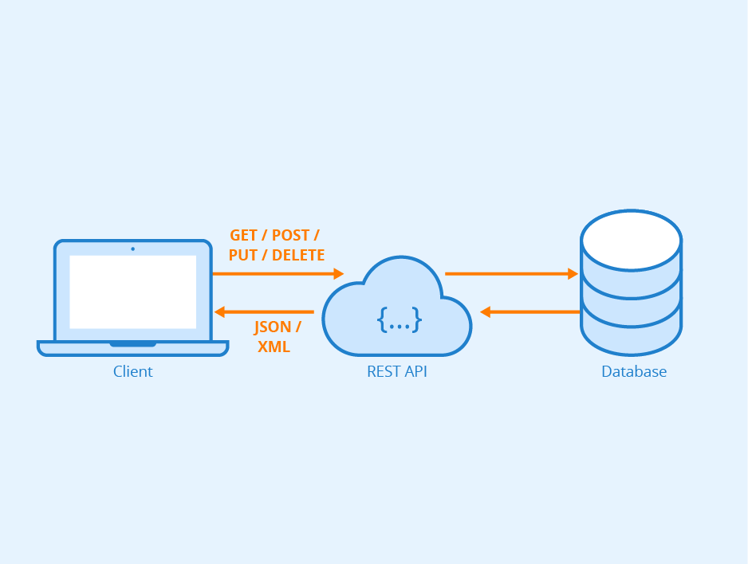
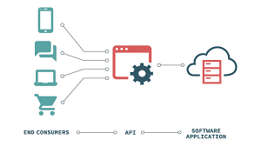
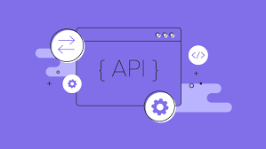
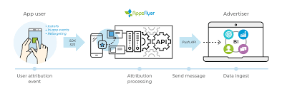
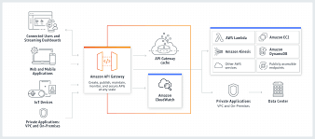
API
Notes:
Well if you Google API, you get a bunch of cute little photos giving a diagram of an API, computers, and other “stuff” so-to-speak.
Some of these images are simple, some detailed, some useful, and some not really useful
What I like about them is they all ultimately represent a singular idea clearly represented in this final photo
An API is essentially an interface between a computer, presumably your computer, and some other set of information or database elsewhere in the ether of the internet
(next slide

Slide 3
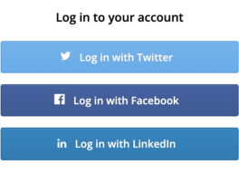
Application Programming Interface
API = Application Programming Interface
“A set of functions and procedures allowing the creation of applications that access the features or data of an operating system, application, or other service.”
Oxford Dictionary
Example: Sign-Up with Google/Facebook/LinkedIn
Notes:
And this idea of interfacing is baked right into the name: API stands for application programming interface
Here’s the Oxford Dictionary definition of it which is a bit obtuse, and it basically means that something, an API, helps two very different systems talk to and interface with one another
I think the idea is best illustrated with an every-day example
If you’ve ever gone to a website that asks you to make an account with them, you’ve probably seen the option that allows you to sign-up with your Google or Facebook or LinkedIn or Twitter account
Those websites don’t actually take your log-in information for those social media giants because that’d be a huge security risk.
Instead, if, for example, you’re using FaceBook to log-in or sign up for a website, you’re actually allowing the website to check that you’re already logged-in to FaceBook on your computer, and then the website sends a request to FaceBook for the information it wants from your FaceBook profile like your name, age, gender, phone number, and so on.
That info is returned from FaceBook's API in a relatively standard format that lets the requesting website easily parse out the data so all of that info about your name, age, and so on fills in the right spaces in the website's database
At the core, what happened in this example is that one website asked for neatly-formatted information from another website. How does website A actually make this request for data to website B?

Slide 4
HTTP
Hypertext Transfer Protocol
Standardized language for communication between web browsers and data servers
Details irrelevant for this presentation on Qualtrics, but useful to learn HTTP for expanding your skills!
Notes:
The process uses a language called HTTP or Hypertext Transfer Protocol which should be familiar to you at least in passing!
In fact, your computer interfaces with websites using HTTP or more recently HTTPS. You see it every time you type a weblink into your address bar in Google Chrome!
It actually means you’re submitting a Hypertext Transfer Protocol request to a web address so you can see the website in all its beauty
And so, simply put, HTTP is just a language for communication between web browsers, computers, and servers
It’s useful because it provides a standard language to request information from websites that might have their data structured in different ways.
The details otherwise aren’t relevant, but I think it’s good to understand that every time you want to log-in to a site or pull data programmatically from somewhere, it almost certainly relies on an HTTP request
Ok, enough boring details. What does this all have to do with Qualtrics?

Slide 5
Qualtrics API
Systematically download survey data!
Notes:
Well, Qualtrics unsurprisingly has an API!
And like other APIs, theirs allows you to request data.
Their API let’s you easily access and download all of the data from your Qualtrics account
By all of your data, I particularly am talking about the data from any and all surveys available in your account
What this means is that there’s no need to log-in to Qualtrics via MyAccess every and anytime you need to download more data from a survey
The API essentially allows you to automate your download process, and ideally any cleaning steps, into a single coding script.
As a cherry on top of all this, someone wrote a package in R that takes care of all of the HTTP work and the API programming issues. The package is great, and as you’ll see later, there are about 3 total functions you’ll need to learn to get your data from Qualtrics in a nice data frame format
But first, why should you care about automating this process?

Slide 6
Why automate?
Speed and convenience
Reduce mistakes in process
Consistent procedure and documentation for future CRCs
Notes:
Well, it’s just faster and convenient to press a single button to download your data!
Moreover, a script that does everything for you greatly reduces the risk of making mistakes in the download and cleaning process
And, because I know the lack of SOPs and manuals plagues many groups at the MAC, automating this process allows for a clear and consistent procedure that can be passed along to future staff.
In essence, the code both does the work for you, and with a few notes peppered in, can also serve as documentation of your process

Slide 7
What can we automate?
Downloads of data from Qualtrics
Any requisite data cleaning
Preparing column names for LAVA
E.g. adding “SKIP” to column names
Notes:
So what can easily be automated out of the process of Qualtrics data to LAVA?
Well, we can download the data
We can clean the data by removing missing values and performing any calculations that might need to be done if you have some more intermediate R skills
And, assuming you’re familiar with LAVA import definitions, I will show you how you can prep the data for LAVA import by removing columns or appending “SKIP” to columns that are meant skipped in the import process

Slide 8
What can’t we automate?
Handling updates to the surveys
Will need to adjust R processing scripts if you change survey names or add columns!
Final step: uploading data via LAVA import tools will still need to be done by hand
Takes <2 minutes!
Notes:
Important to note that if you make changes to your survey, you might also need to make changes to the script but this would go hand-in-hand with updating all of the LAVA import definitions and SOPs you should have. Right?
And, as of right now, we can’t actually automate the final step of moving the file into LAVA, but using the LAVA import tool manually only takes a handful of minutes assuming you’ve already set up an import definition
If LAVA isn't the final destination of your data, don't worry. The lessons and tutorial here will still be largely generalizable.
With that, we’ll jump into the process

Slide 9
What you’ll need
R + RStudio
{tidyverse}, {qualtRics} and {keyringr} packages for R
Encouraged: Git + GitHub account to track changes in your scripts
Notes:
Unsurprisingly, you’ll need the R software and I recommend RStudio
You’ll want to download the three packages listed here.
Convenionetly, someone made an R package that interfaces with the Qualtrics API so you don’t need to know how to write HTTP code requests. All of the heavylifting has already been done for you.
And I encourage people to use Git and GitHub to track changes in scripts. I would particularly encourage using a version control system for scripts like this that will be managing data so there’s always a history of how your data was managed
I’ve covered all of these topics in some of my previous sessions, but you can also Google for quick tutorials on downloading R/Rstudio, and installing the R packages above in case you’ve never used it.
Assuming you have all of these installed, what do we do?

Slide 10
Process Overview
Set up Qualtrics API Token
1
GET data from the Qualtrics API
2
Clean and upload data
3
Notes:
There are 3 major steps in this tutorial
We’ll start by getting your Qualtrics API Token set up.
If you’re not familiar, a token is essentially another name for a password except it’s a very long, randomly generated code made by the website you’re using and it’s linked to your specific account. Never share it.
Next, I’ll show you how to use R code and the API token to download data from Qualtrics
And finally, I’ll show you how to do some common data frame manipulation that you’ll want to accomplish before uploading your data to LAVA

Slide 11

1. Qualtrics API Token Set-Up
Gather your Qualtrics API Token from your account
Press -> Account Settings -> Qualtrics IDs -> copy the API Token
Store API Token in your OS password manager
KeyChain on Mac
Recommend labeling it “Qualtrics_API_Key” or similar
Notes:
This part of comprised of 2 steps
Finding your API token in your Qualtrics account and
Storing the API token in your password manager
Let’s watch a short clip demonstrating

Slide 12
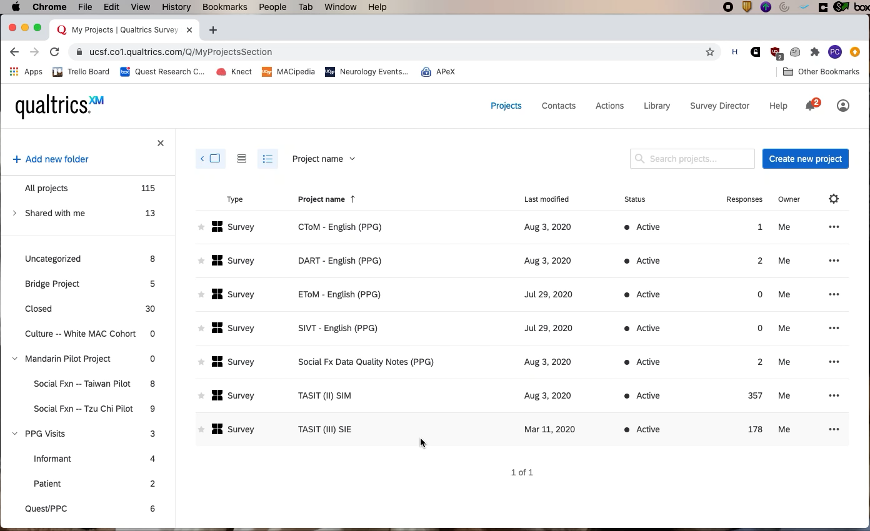

Slide 13
2. GET Data from Qualtrics
Establish access credentials in your R script
qualtRics::qualtrics_api_credentials(api_key = keyringr::decrypt_kc_pw("Qualtrics_API_Key"), base_url = "ucsf.co1.qualtrics.com")
Will be prompted to allow access to KeyChain; enter your computer password
Access complete list of your surveys and IDs
qualtrRics::all_surveys() %>% View()
Query surveys for their data by ID
qualtRics::fetch_survey(surveyID = “”, force_request = T)
Notes:
Now we want to leverage some R code and the API token to actually download the data
This can be split into three steps
You need to authenticate your computer, and you do this by running the qualtrics_api_credentials() command.
You’ll see, highlighted in yellow, that we’re using a function called decrypy_kc_pw() which is pulling our Qualtrics API token from the computer password manager.
You’ll also see that there’s a link listed under the base_url argument. Copy that website address exactly
After your computer is authenticated, you’ll want to pull a list of all the surveys currently available in your library with the all_surveys() function
Finally, after you identify the survey for which you want data, you can run the fetch_survey() function where you specify the surveyID.
I think this is more clear when done interactively so let’s take a look at another video, one that will outline all of these steps.

Slide 14
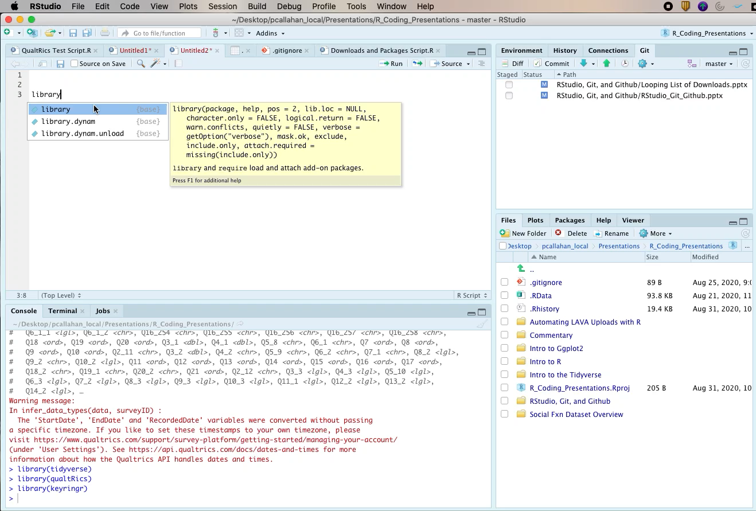

Slide 15
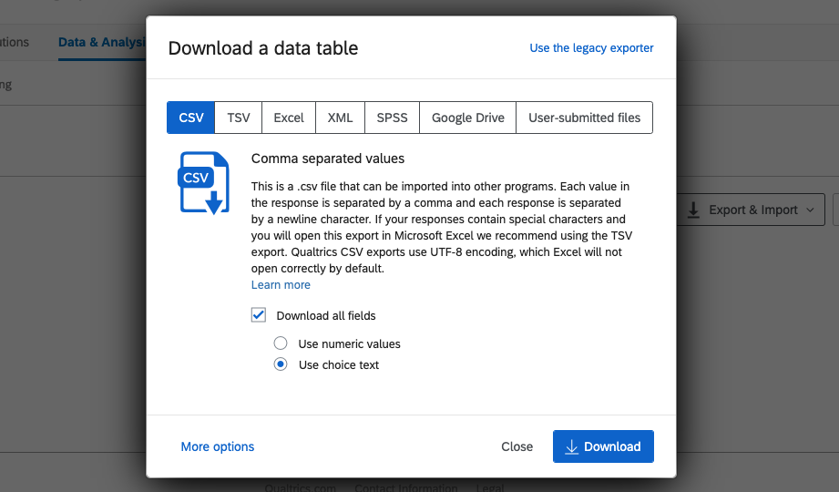
Choice Text vs. Numeric
Notes:
I want to quickly talk about the output of the data from Qualtrics when we use this API method
If you’ve ever exported data from Qualtrics, you probably know that you can either get output that is the exact text, or Choice Text, version of the data, or you can get the underlying numbers, or Numeric Output

Slide 16
Choice Text vs. Numeric
Choice Text Output
Numeric Output
Notes:
The code I showed in the previous example provides the Choice Text results
You can also get the Numeric Values if you add these two arguments to the fetch_survey() function: label = FALSE and convert = FALSE.
After you’ve made the determination between how your data should be downloaded from Qualtrics, we’re all set to move on to the final preparation step

Slide 17
3. Clean and Upload: Existing Import Definitions
Add “SKIP:” to column names where needed
dplyr::rename_at(vars(…), ~paste0(“SKIP:”,.))
Perform other data cleaning as needed
Turn file into a .CSV, and upload through LAVA
readr::write_csv(path = “”, na =“”)
For short-use files like this, I usually set path to “~/Desktop/file_name.csv”
Notes:
If you have existing import definitions for Qualtrics or other surveys, you might know that you have to manually label some of the variables in your data-frame with the word ”SKIP:” to tell LAVA to skip reading those variables
The code here, this rename_at() function, is a shortcut to rename any variables that need to have this “SKIP:” label added.
You can use this code as-is: all you need to do is add the names of the variables you want to rename inside of the vars() function
You may have some other miscellaneous data cleaning that you can complete in R
Finally, you’ll presumably want to write your data to a csv file and you can do that using the write_csv() function.
You’ll need to specify a path function, and I usually send my files to the desktop if they’re temporary.
You’ll also want to set this na = “” argument as it will keep empty observations empty. The default behavior is to write the word NA

Slide 18
3. Clean and Upload: Create a New Import Definition
Work with MAC Tech Team to create a new import definition
Recommendation: drop columns not uploaded to LAVA rather than using “SKIP:” feature
Use dplyr::select() to select only the columns you want to upload
Return steps from previous slide
Notes:
If you don’t have an import definition for your data and think you need one, talk to the MAC tech team.
When setting it up, I recommend that you don’t create an import definition that requires using the “SKIP:” labels because it’s really error-prone if you do it manually
After you have an import definition, you can return to the steps from the previous slide
So with that, let’s see all of this in action in a video again because it’s easier demonstrated than discussed.

Slide 19
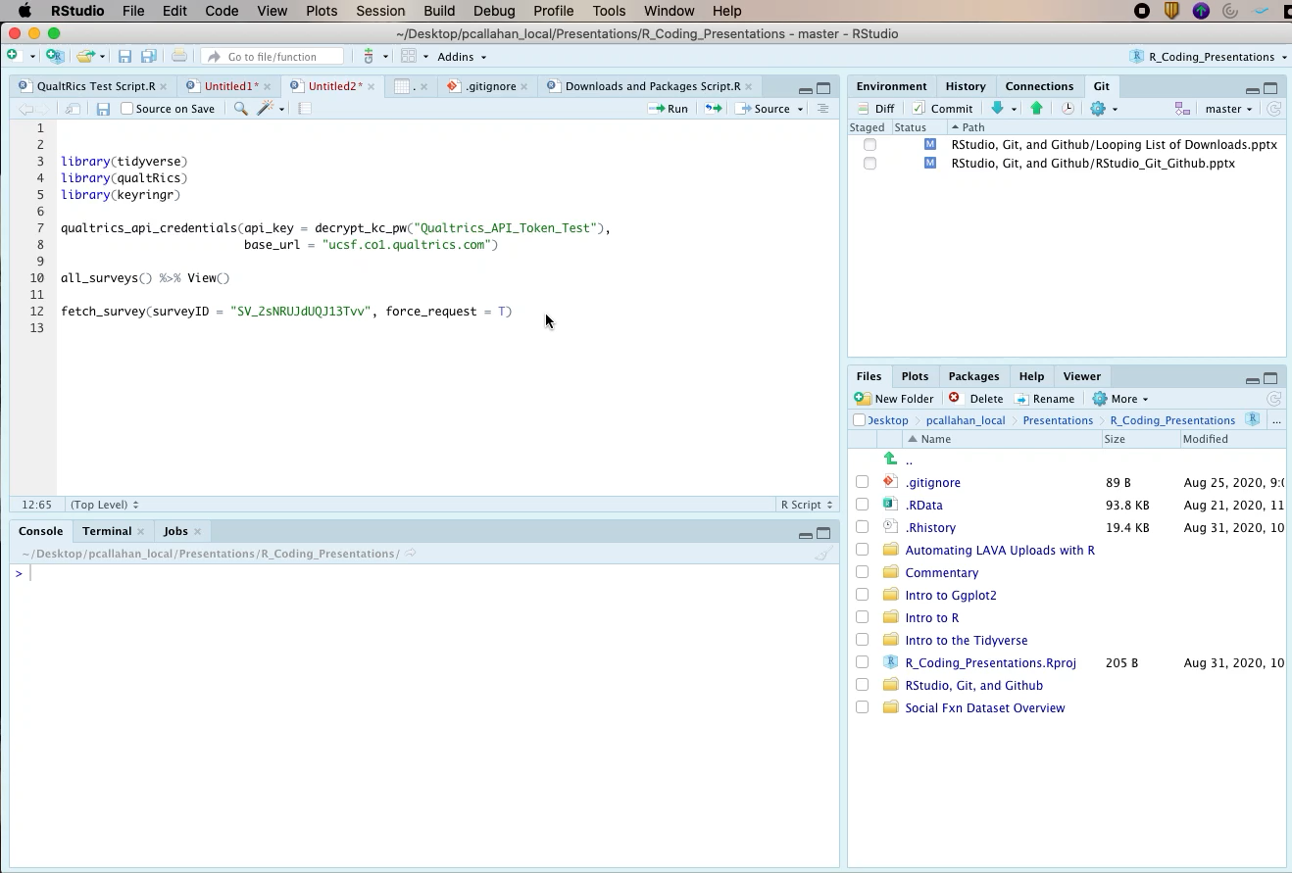
Notes:
Fetch_survey again
Rename with SKIP
Select to remove
Filter for data cleaning
write_csv to send the results to our desktop with na=""

Slide 20
Questions?
Make sure the survey you want to get data from is not closed!
If all else fails, contact Qualtrics@ucsf.edu to make sure that your account is allowed to access the API
Notes:
Note that some accounts aren’t activated for the API, but you can email Qualtrics@ucsf.edu to get this activated
Happy to answer questions if there are any. But otherwise, I hope this video serves as some good reference material should you want to automate even part of your Qualtrics to LAVA data processing!

